Slide 1
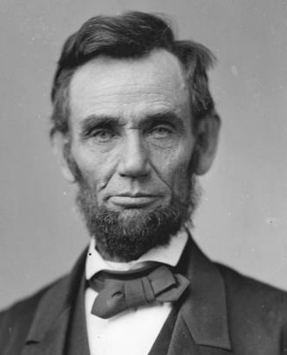
Chapter 13
The Coming of Civil War

Slide 2
The Fugitive Slave Act of 1850
Made it illegal to hide or rescue runaway slaves
  Southerners actively pursued Free Blacks in the North
Many Free Black Communities in the North were subjected and destroyed
Of 332 African Americans put on trial
  300 were placed into slavery

Slide 3
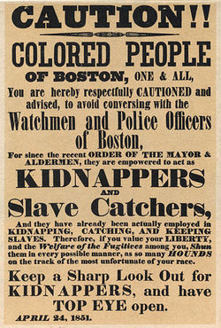

Slide 4
“Uncle Tom’s Cabin”
Written by Harriet Beecher Stowe
  Not an Abolitionist or a professional writer
  Was struck by the injustice seen in the Fugitive Slave Act
Told the story of runaway slaves escaping north
Southerners were outraged
  Called her view of slavery “distorted”

Slide 5
The Election of 1852
Democratic Party presented three candidates
  Stephen A. Douglas
  James Buchanan
  Lewis Cass
Whig Party presented one candidate
  General Winfield Scott
    General responsible for taking Mexico City

Slide 6
Whig Issues
The Whigs were becoming increasingly divided
Southern Whigs were proslavery
    “Cotton Whigs”
Northern Whigs were antislavery
    “Conscience Whigs”
The Whig Ticket was severely hurt by this during the Election

Slide 7
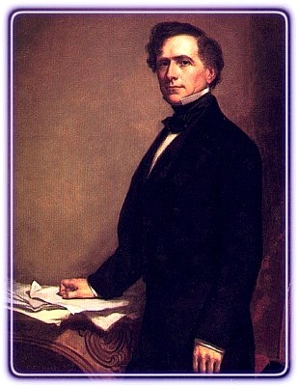
Democrat Issues
Cass and Buchanan were favored
  Douglas was eliminated from the race
The Democratic Party was split between the two
  A sudden Dark-Horse candidate is selected
  Franklin Pierce

Slide 8
Pierce Wins, Troubles Continue
Franklin Pierce wins the election
  A shift occurs in the house
  Due to the Whigs Party’s divisions
Southern Democrats become the majority in Congress
  They are proslavery

Slide 9
Pierce as President
Pierce’s win was unexpected, but appropriate
  He was a former General in the Mexican-American War
  He was served in both Houses of Congress
He was committed to being balanced
  Jefferson Davis of Mississippi-Secretary of War
  William Marcy of New York-Secretary of State
Pierce was not a firm enough leader to maintain the balance.

Slide 10
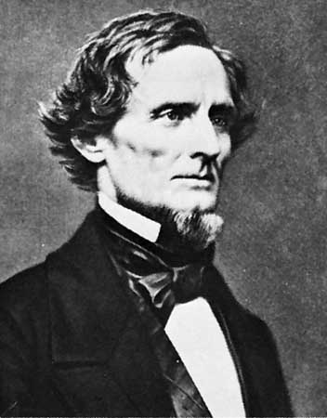
Jefferson Davis

Slide 11
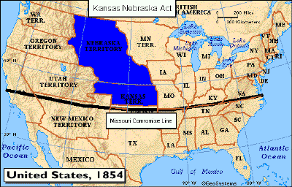
The Kansas-Nebraska Act
The land west of Missouri was now able to be organized
  Led by Stephen A. Douglas

Slide 12
Problems
Nebraska Territory stood above the Missouri Compromise line
  It would, presumably, be a series of Free States
Douglas, under pressure, divided Nebraska Territory into two territories
  Nebraska and Kansas
This, in essence, repealed the Missouri Compromise
  No Slavery North of 36-30

Slide 14
The Problems
Douglas would argue that, like California, the Slavery issue should be left to the new territories to decide
  Northerner’s are infuriated
Abolitionism explodes in the North
  Reaction unseen since the Stamp Act
The Bill passes
  America takes its biggest step yet towards division

Slide 15
Results of Kansas-Nebraska Act
91 “Free State” Democrats before the Bill
  Only 25 after
The defectors created two new parties
  The “Know-Nothing” Party
  The Republican Party
The Whig Party was all but dead at this point

Slide 16
The Know-Nothings
Also called the “American Party”
Received its nickname due to a password used by a former secret society
  “I don’t know”
Nativists
  Believed that Immigration was a problem
  Spoke out against Irish Catholic Immigrants
  Believed that they were responsible for rampant crime

Slide 17
The Republicans
Made of up
  “Free Soilers”
  “Conscience Whigs”
  “Anti-Nebraska” Democrats
Were not Abolitionists
  Were against Slavery in New Territories

Slide 18
Kansas Bleeds
Congress opened settlement in Nebraska and Kansas May 1854
  Few settlers owned slaves nor cared about slavery
Kansas had a unique mix or Northerners and Southerners
  Was slavery legal?
Northern Interest Groups began assisting antislavery settlers
  Paid expenses to move into Kansas

Slide 19
Kansas Bleeds
Many people in Kansas were from Missouri
  Supported Slavery
Kansas was to elect a territorial delegate
  Many Missourians crossed into Kansas to vote
There were only 2,905 legal voters in Kansas
  Over 6,000 votes were cast

Slide 20
Kansas Bleeds
Anti-Slavery populations refused to recognize this Government
  They elected a delegate of their own
The Slave Government was fraudulent, but legal
  President Pierce denounced the Anti-Slave Government because it was illegal
This denouncement encouraged Proslavery “Border Ruffians” to go on the offensive

Slide 21
Bleeding Kansas
Proslavery militants sack the town of Lawrence, KS.
  Five anti-slave men are murdered
John Brown, a local extremist, takes the law into his own hands
  He murders five Proslave men near Pottawatomie Creek
Violence and chaos breaks out

Slide 22
Bleeding Kansas
When the fighting subsided, Brown escaped capture and went into hiding
Republican Newspapers deemed the event “Bleeding Kansas”
  Used it as political propaganda
Ultimate blame will fall to President Pierce
  Governor complained that voting in Kansas was fraudulent
  Pierce replaced him with a Proslavery Southerner

Slide 23
Sumner Falls
Charles Sumner was a Congressman from Massachusetts
  Was hated by his Southern Colleagues for his outspoken stance on Slavery
  Wrote a statement “The Crime Against Kansas”
  Would berate fellow Congressman Andrew Butler of South Carolina
    Butler was elderly and not present to defend himself

Slide 24
Caning of Sumner
Preston Brooks of South Carolina
  Nephew of Butler
Attacked Sumner after a session of Congress with a cane
  Stuck Sumner over thirty times until unconscious
  Sumner survived, but was unable to continue to serve in the House of Representatives
Both sides use the event as propaganda

Slide 25
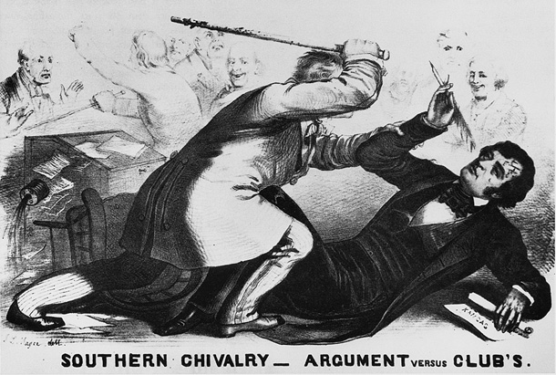

Slide 26
Buchanan Becomes President
The Election of 1856 saw:
  Republicans dominate the North
    Nominated John C. Fremont- “The Pathfinder”
  Democrats were unhappy with Pierce
    Nominated James Buchanan of Pennsylvania
The Democrats claimed that Republicans were sectional
  Highlighted that Sectionalism would dissolve the Union

Slide 27
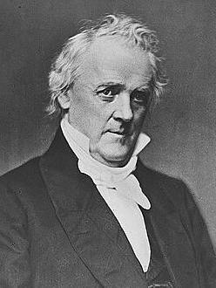
Buchanan Wins
Served as Minister to Britain
Born outside of Shippensburg ,PA
PA’s only president

Slide 28
Dred Scott Divides the Nation
Dred Scott was the personal servant of a wealthy Army doctor
  Upon the Doctor’s death, Scott petitioned for his freedom
  Believed since he was in Illinois, a free state, he should be free
The courts decided that African Americans were not citizens
  Regardless of Free or Slave, Scott could not legally petition the court

Slide 29
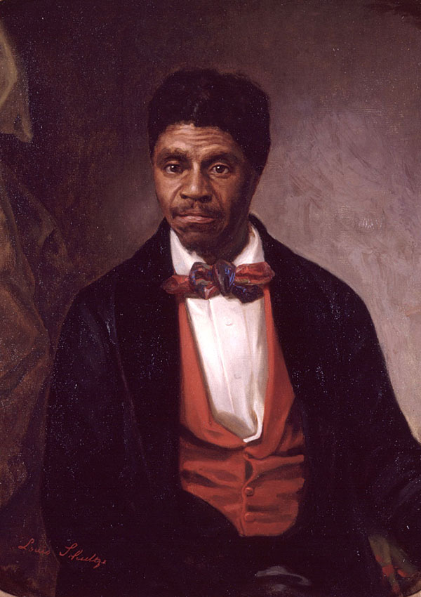
The Court believed that the Missouri Compromise no longer held precedence
Northerners believed that the South had an aggressive agenda to spread slavery at all costs

Slide 30
1857-Days Darken
A depression begins in 1857
  Northerners blame Southern-dominated Congress
  Southerners preach the economic stability of the Slave system
    “Depression-Proof”
Many believe that the Union could dissolve
  A strong leader is needed to hold it together

Slide 31
Stephen A. Douglas
Democrat
Senator of Illinois
  Up for reelection in 1858
The Nation’s eyes were upon the small, senatorial election
  Many believed a Douglas win would take him to the White House in 1860

Slide 32
Douglas’ Opponent
Republicans wanted a strong candidate to challenge Douglas
  Party chose Illinois Congressman Abraham Lincoln

Slide 33
Lincoln’s Record
Received a seat in the Illinois legislature at the age of 25
Would become a practicing lawyer
Elected to Congress in 1846
Took a practical stance on slavery
  Southerners “are just what we would be in their situation”
  “A house divided against itself cannot stand… I believe this government cannot endure permanently half slave and half free.”

Slide 34
The Debates
During the campaign for Senate, Lincoln challenged Douglas to a series of debates
  Seven in total
The debates were wildly popular and well-attended
  Douglas always wore the finest garments and made grand entrances
  Lincoln dressed simply and preferred to walk with his supporters

Slide 35
The Debates
Douglas’ strategy
  Make Lincoln, a moderate, look like an Abolitionist
  Claimed Republicans favored racial equality
  Made himself appear heroic by standing against the Republicans and Buchanan-favoring Democrats

Slide 36
The Debates
Lincoln’s Strategy
  Make Douglas appear as a Proslavery advocate
  Highlight his support of the Dred Scott case
  Lincoln asks Douglas if slavery can be outlawed in a territory before it is a state if supported by its citizens
    Douglas claims that it can based on popular sovereignty

Slide 37
The Moment
Douglas wins the election in Illinois, but becomes an enemy of Southerners
  Douglas essentially supported a repeal of the Dred Scott Decision
That statement will be known as “The Freeport Doctrine”
  The debate occurred in Freeport, Illinois

Slide 38
Southern Reaction-Fire Eaters
Radical Southerners became outspoken
  If a Republican became elected President in 1860 the South should leave the Union
  These radicals were known as “Fire-Eaters”
  They demanded a Federal Slave Code for all territories
  Also proposed that Cuba be annexed for the purposes of the Slave Trade

Slide 39
John Brown’s Raid
John Brown, the Kansas radical, devised a plot to end slavery
  He and his men would capture a Federal Arsenal in Harpers Ferry, VA
  They would steal the weapons and arm slaves
  He and his new army would establish an All-Black republic in the mountains of VA

Slide 40
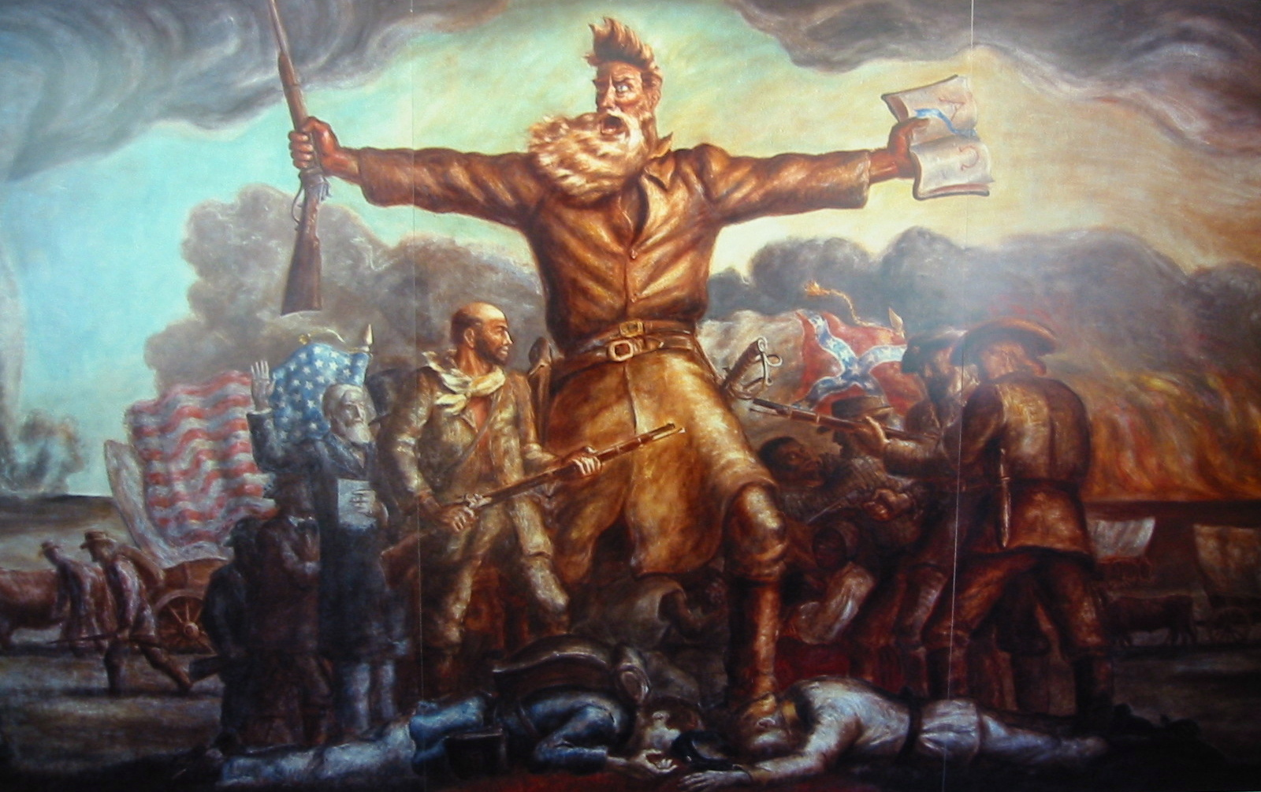

Slide 41
John Brown’s Raid
Brown and his small band of men easily overpowered two night watchmen
  He did not, however, get much support from local slaves
Brown was now trapped inside the Federal Arsenal and surrounded by US Army troops
  Leading the unit was Robert E. Lee and J.E.B Stewart

Slide 42
Brown Subdued
Brown is put on trial and sentenced to death
Northerners saw him as a martyr for the antislavery cause
  Despite his terroristic actions in Kansas and Harpers Ferry
Southerners saw him as a violent radical
  Embodiment of the Abolitionist cause

Slide 43
The Election of 1860-Democrats
The nation was now hotly divided
  Northerners and Southerners were at odds over slavery
Many saw Stephen A. Douglas as the last hope for keeping the Union together
  The Democratic Party could not agree on Douglas
  Southerners would not support him
    Must allow slavery undisturbed in the territories

Slide 44
The Election of 1860-Democrats
Democrats select two candidates
  North chooses Douglas
    Support Supreme Court
      Freeport Doctrine
  South chooses John C. Breckenridge
    Buchanan’s VP
    Neither Congress nor any territorial government could prevent citizens from their property

Slide 45
The Election of 1860-Republicans
Ran on several popular platforms
  A high tariff for manufacturers
  Free land for settlers on the frontier
  Promised to “abide by the decision of the Supreme Court” regarding slavery

Slide 46
The Election of 1860-Republicans
There were several promising candidates
  William Seward
  Salmon P. Chase
  Abraham Lincoln
Seward was viewed as incapable of winning key states like PA, IN, and IL
Chase was seen as too radical due to Abolitionist sentiments

Slide 47


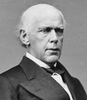


Slide 48
The Decision for Lincoln
Neither man could win a majority
  The nominating convention was divided
Due to the divisions, Lincoln received the most votes
  The convention was held in his home state of Illinois

Slide 49
The Race
Divisions cause conflicts during the Election
  Democrats cannot win support of Northern States due to its ambiguity regarding slavery
  John Bell and Breckenridge divide votes from the South and West
  Lincoln wins a clear majority due to support of Northern states and territories
Lincoln is elected as the 16th President of the United States

Slide 50
The Results: South Carolina
South Carolina’s delegates decided that it would secede from the Union
  Six other states followed
One week later, a provision in Montgomery, AL created the Confederate States of America
Virginia, Tennessee, NC, and Arkansas did not secede
  If the Union attacked the Confederate States, they would secede

Slide 51
How It Happened
Many Northerners considered it a bluff
Lincoln believed the threat was hollow
  Meant to stop him from accepting the Presidency
Southern States selected Jefferson Davis as President

Slide 52
